Slide 1
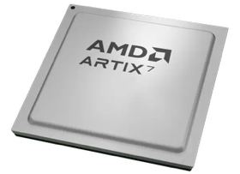
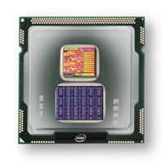
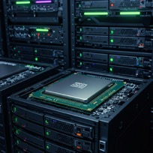
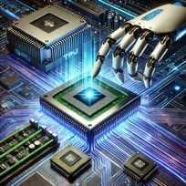
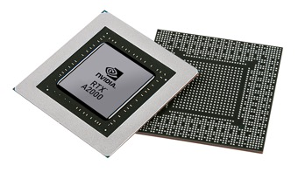


Christof Teuscher
ECE 410/510: Hardware for AI and ML
GPUs + CUDA + CNN/DNN
Portland State University
Department of Electrical and Computer Engineering (ECE)
www.teuscher-lab.com
teuscher@pdx.edu

Slide 2
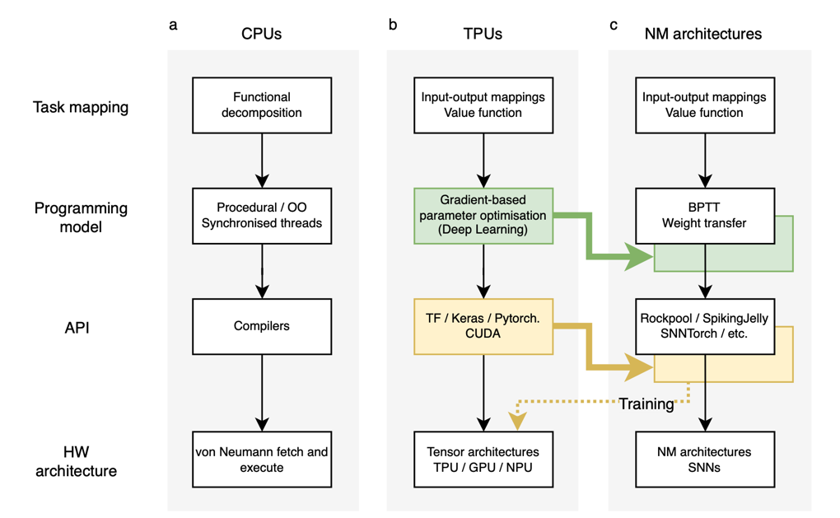
Backpropagation Through Time (BPTT)
https://doi.org/10.1038/s41467-025-57352-1

Slide 3
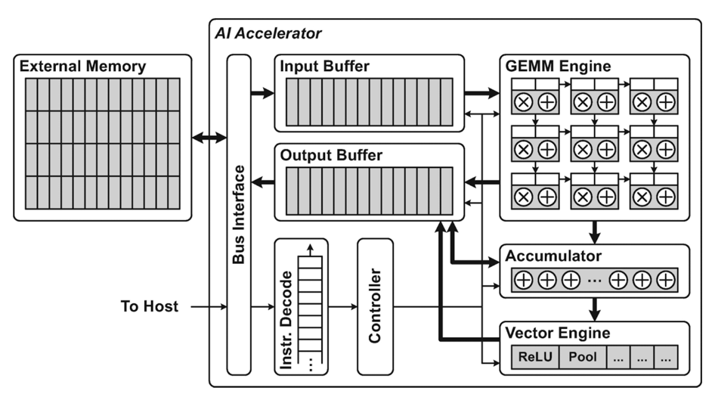
General AI accelerator architecture
GEMM = General Matrix Multiply
Tensor cores!
A vector is a 1st-order tensor
A matrix is a 2nd-order tensor.
Mishra, Ashutosh; Cha, Jaekwang; Park, Hyunbin; Kim, Shiho. Artificial Intelligence and Hardware Accelerators, 2025

Slide 4
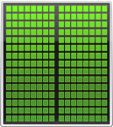


General co-processing mechanism
Application Code
Rest of Sequential
CPU Code
GPU
Compute-Intensive Functions
CPU
Use GPU to Parallelize
NVIDIA
Notes:
Your time is precious, which is why performance is critical. So you need to focus on what’s important.
To add GPU acceleration, simply identify and accelerate the *performance-critical areas* in your application.
The rest can run as-is on the CPU. There’s no need for an entire application to be ported to the GPU.
The key point here is that in a hybrid architecture where GPUs and CPUs are working together, developers only need to accelerate performance-critical functions on the GPUs in the system.

Slide 5
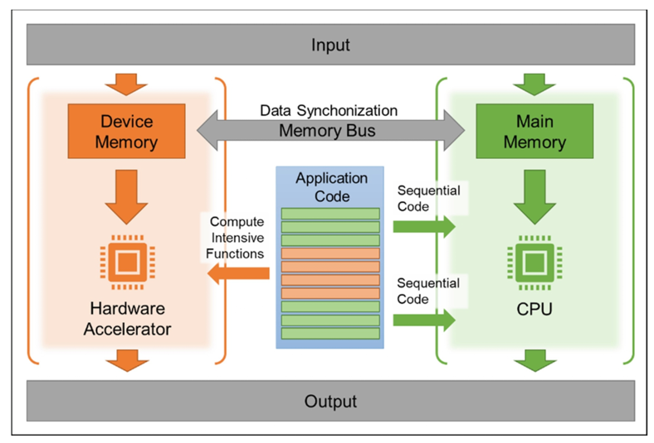
General co-processing mechanism
Mishra, Ashutosh; Cha, Jaekwang; Park, Hyunbin; Kim, Shiho. Artificial Intelligence and Hardware Accelerators, 2025

Slide 6

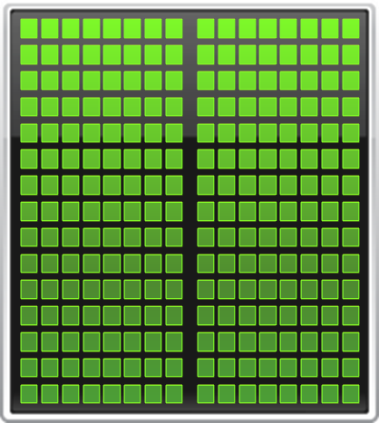
Multi-core vs GPU
CPU
GPU
NVIDIA
Notes:
GPU Computing is a type of heterogeneous computing – that is, parallel computing with multiple processor architectures. In GPU computing,
Many-core GPUs are combined with multicore CPUs to achieve higher performance.
Today’s CPUs have 4, 6, 8 or even 12 cores, while GPUs have up to 512 cores in a single chip.
Today’s computing applications typically have data intensive regions with a large amount of inherent parallelism. GPUs accelerate these parallel
Regions by spreading the computation over hundreds of cores. This can deliver significant acceleration for many applications.

Slide 7
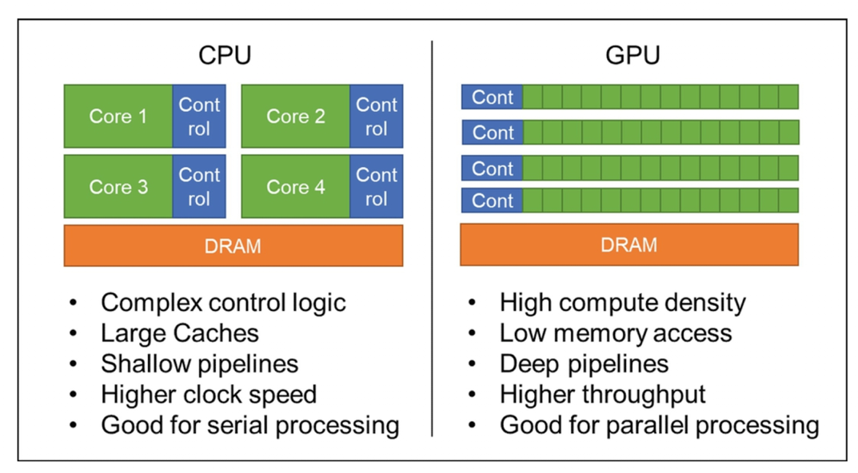
Multi-core vs GPU
SIMT (Single Instruction, Multiple Threads) is a parallel processing model used in GPUs where multiple threads execute the same instruction simultaneously, but on different data.
Mishra, Ashutosh; Cha, Jaekwang; Park, Hyunbin; Kim, Shiho. Artificial Intelligence and Hardware Accelerators, 2025

Slide 8
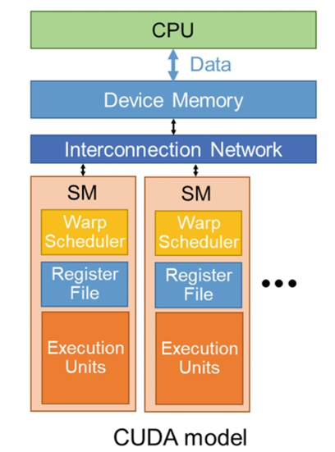
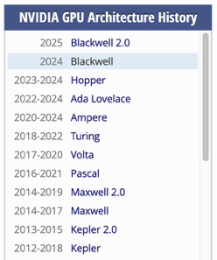
GPU/CUDA model
Mishra, Ashutosh; Cha, Jaekwang; Park, Hyunbin; Kim, Shiho. Artificial Intelligence and Hardware Accelerators, 2025

Slide 9
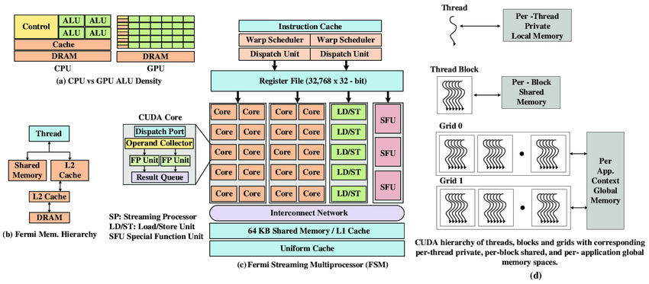
NVIDIA Fermi Microarchitecture
10.1109/ACCESS.2020.3008250

Slide 10
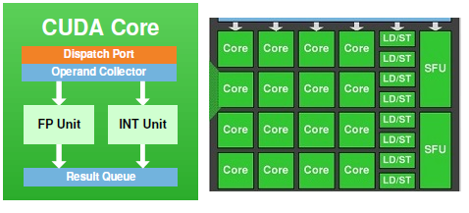
What is a CUDA Core?
FP:
Addition, subtraction, multiplication, division, square roots.
CUDA supports both single-precision (FP32) and double-precision (FP64) floating-point operations
INT:
additions, subtractions, multiplications, comparison, and bitwise operations
SFU:
accelerates the execution of specific transcendental and trigonometric functions like sine, cosine, tangent, and exponential calculations
https://www.electronicshub.org/cuda-cores/

Slide 11
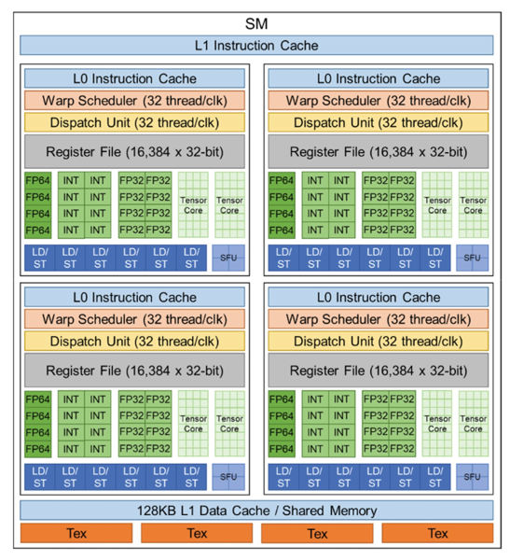
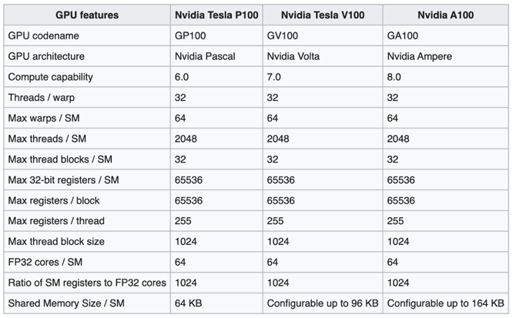
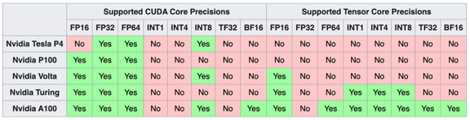
NVIDIA Volta Microarchitecture (2013-2017)
Streaming multiprocessor
Processing block
First chip to feature tensor cores
A GV100 SM is partitioned into four processing blocks
Tex = Texture units
SFU = Special Function Unit

Slide 12
Warp
A "warp" is a group of threads that execute instructions simultaneously on a GPU (Graphics Processing Unit).
The warp scheduler is a component of the GPU architecture that manages the execution of these thread groups.
A warp typically consists of 32 threads in NVIDIA GPUs (AMD calls similar groupings "wavefronts"). These threads execute the same instruction at the same time in a SIMT (Single Instruction, Multiple Thread) architecture.
The warp scheduler is responsible for:
Deciding which warps are ready to execute
Allocating compute resources to warps
Managing warp context switching when threads need to wait for memory operations.
Hiding memory latency by switching between warps

Slide 13
What is a tensor?

Slide 14
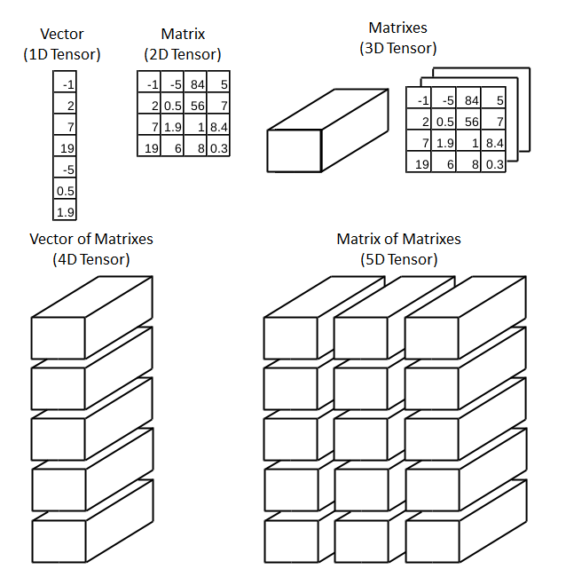
What is a tensor?

Slide 15
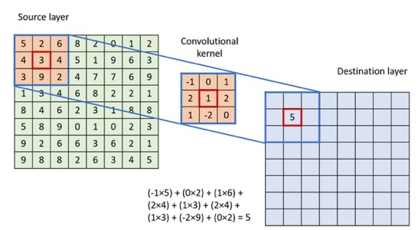
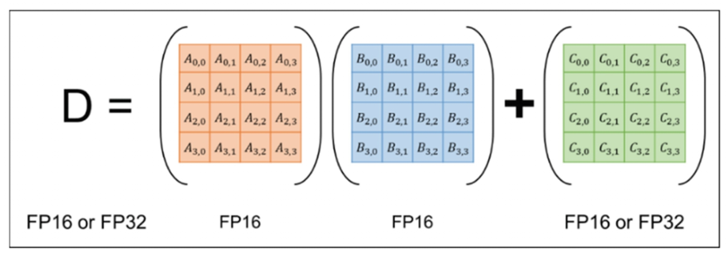
Tensor cores
Each tensor core executes MMA (matrix multiplication and accumulation, D = A × B + C) on a 4 × 4 floating-point matrix.
They are built to enhance deep learning by boosting matrix arithmetic.
Low-precision operations often supported.
Convolution
MMA
Mishra et al., 2023

Slide 16
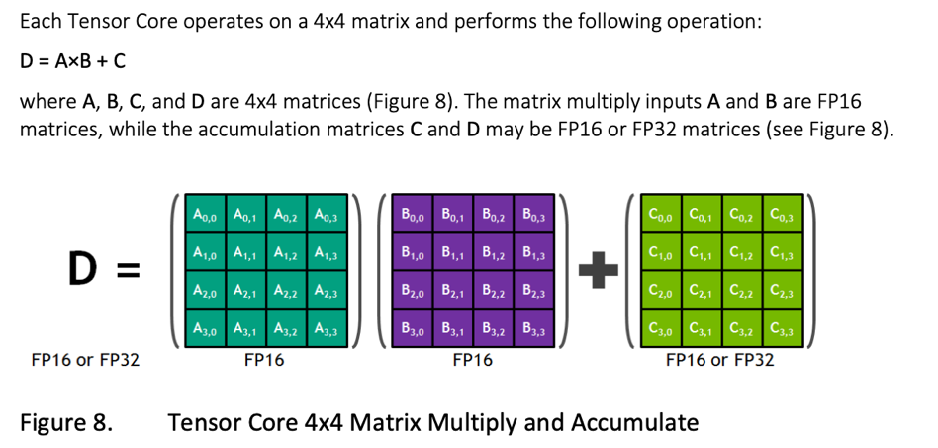
Tensor cores (1)
https://images.nvidia.com/content/volta-architecture/pdf/volta-architecture-whitepaper.pdf

Slide 17
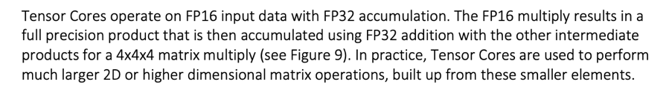
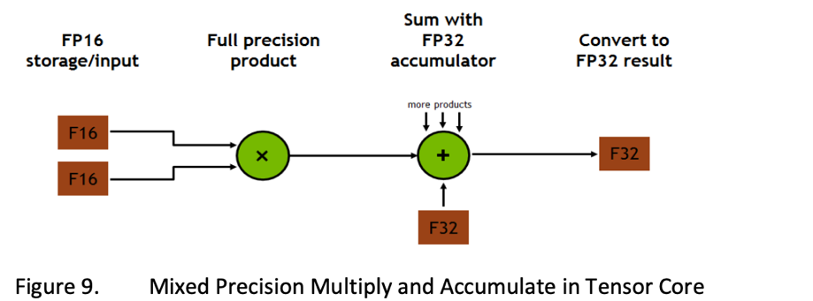
Tensor cores (2)
https://images.nvidia.com/content/volta-architecture/pdf/volta-architecture-whitepaper.pdf

Slide 18
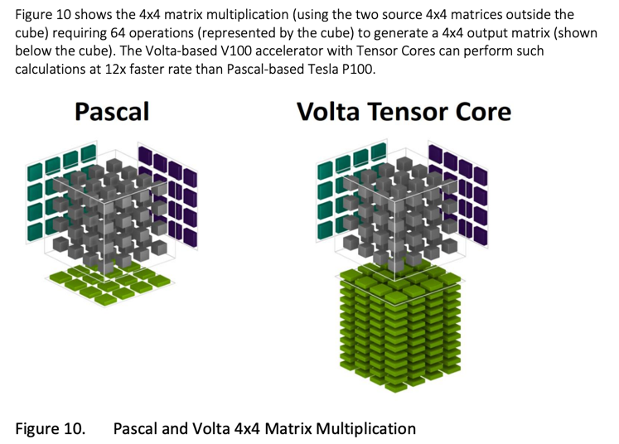
Tensor cores (3)
https://images.nvidia.com/content/volta-architecture/pdf/volta-architecture-whitepaper.pdf

Slide 19
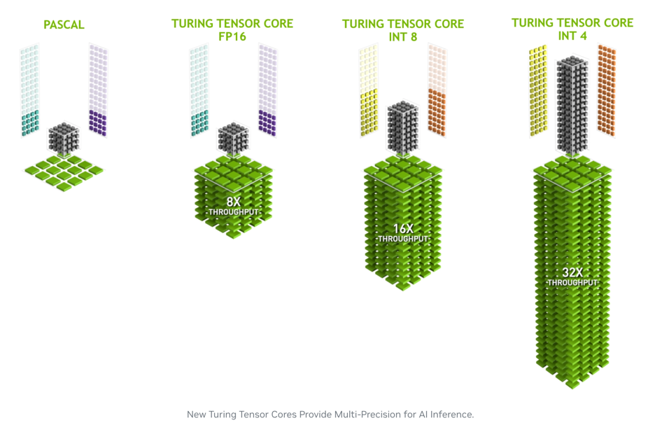
Tensor cores (4)
https://developer.nvidia.com/blog/nvidia-turing-architecture-in-depth

Slide 20
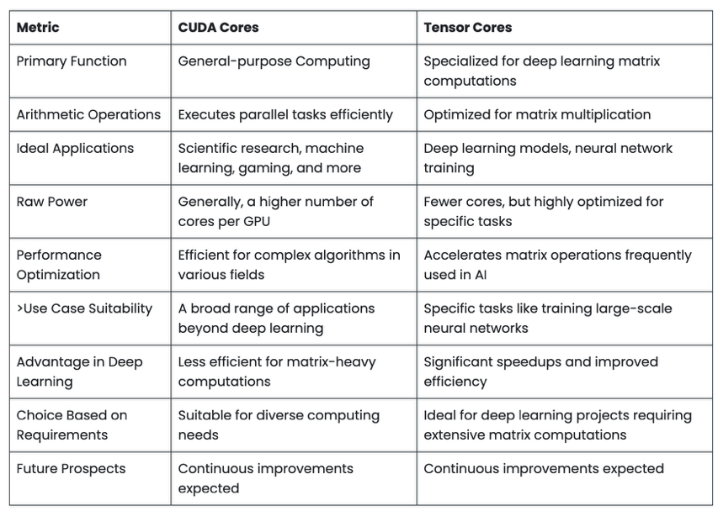
CUDA vs tensor cores (1)
https://acecloud.ai/resources/blog/cuda-cores-vs-tensor-cores

Slide 21
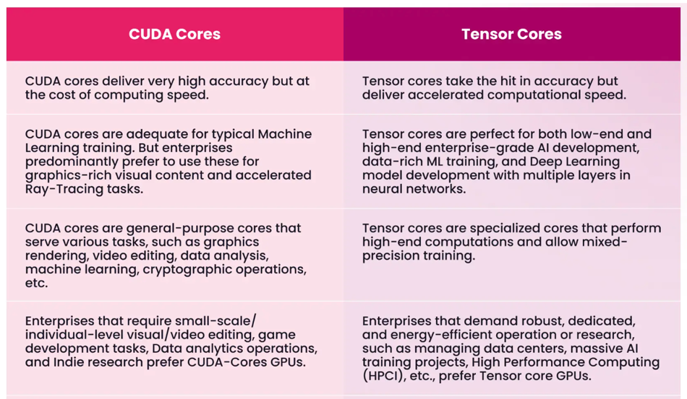
CUDA vs tensor cores (2)
https://acecloud.ai/resources/blog/cuda-cores-vs-tensor-cores

Slide 22
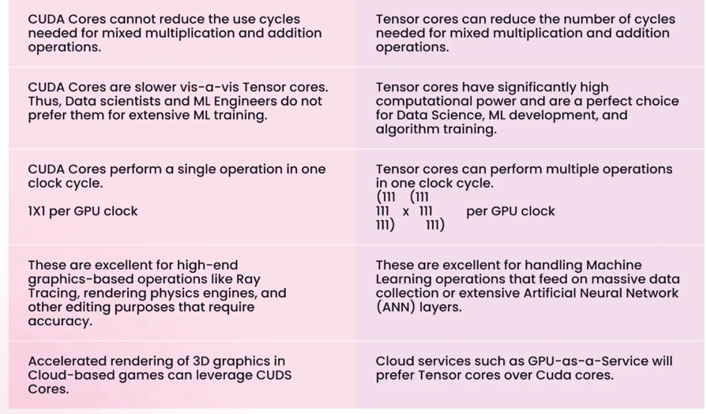
CUDA vs tensor cores (3)
https://acecloud.ai/resources/blog/cuda-cores-vs-tensor-cores

Slide 23
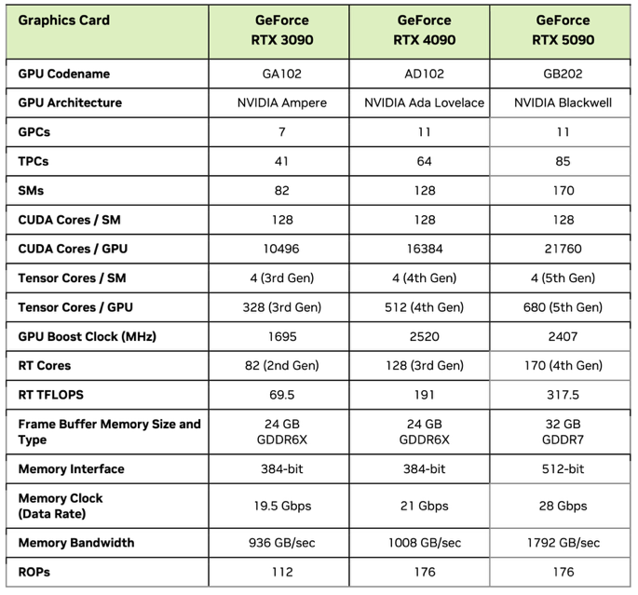
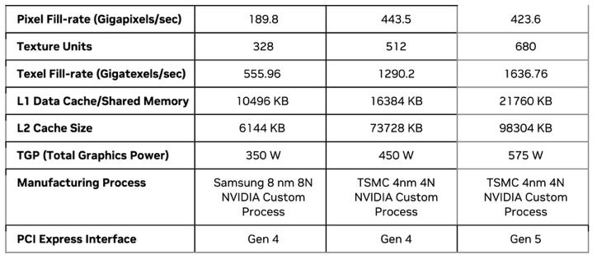
Consumer-grade GPUs
x
=
GPC: Graphics Processing Clusters
TPC: Texture Processing Cluster
SM: Streaming Multiprocessor
RT: Ray Tracing
ROP: Render Output Unit

Slide 24
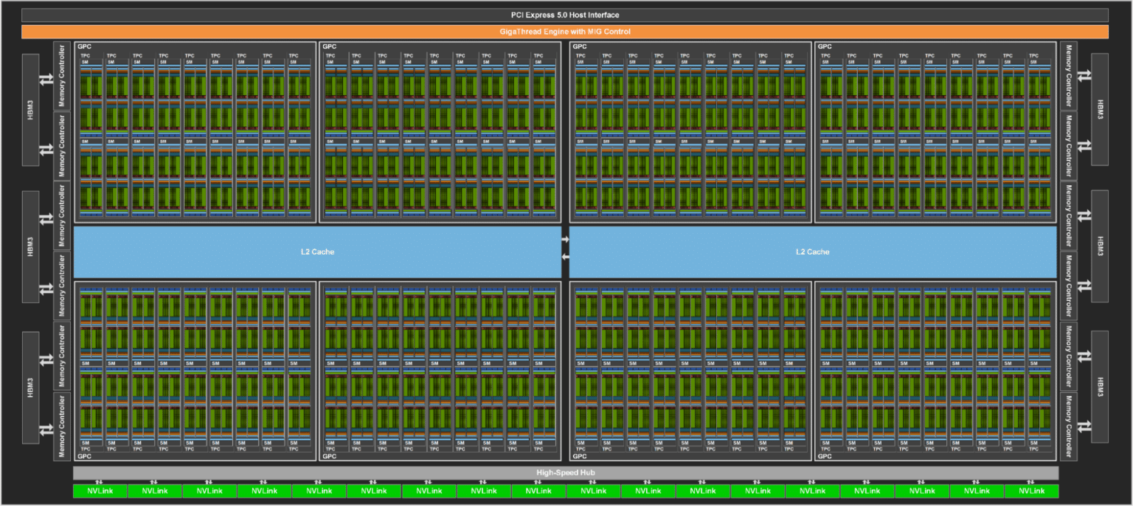
RTX 5090
GPC: Graphics Processing Clusters
TPC: Texture Processing Cluster
SM: Streaming Multiprocessor

Slide 25
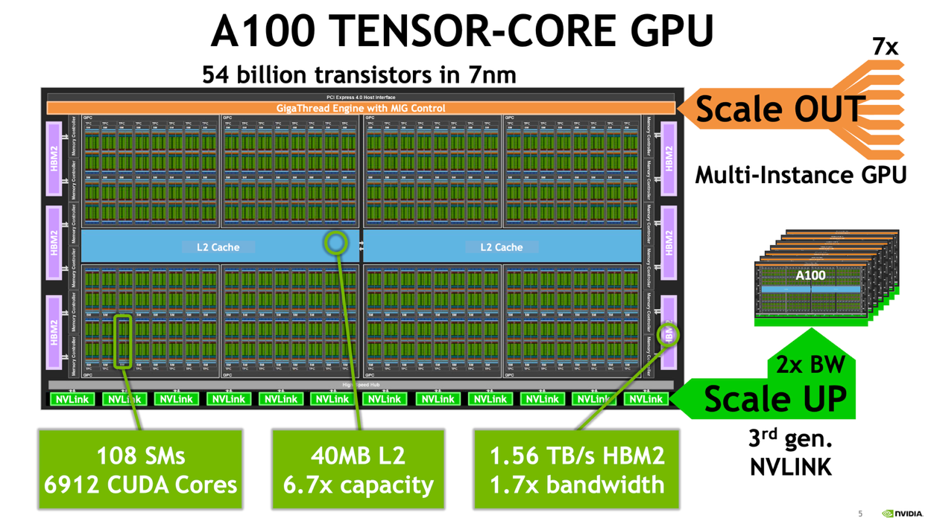
NVIDIA's Multi-Instance GPU (MIG) allows a single GPU to be partitioned into multiple, independent GPU instances, enabling multiple users to run workloads with isolated resources.
No HW oversubscription!

Slide 26
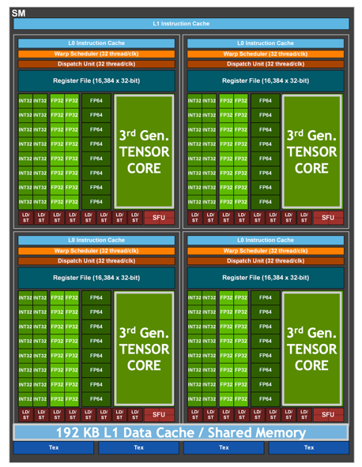
V100
A100

Slide 27
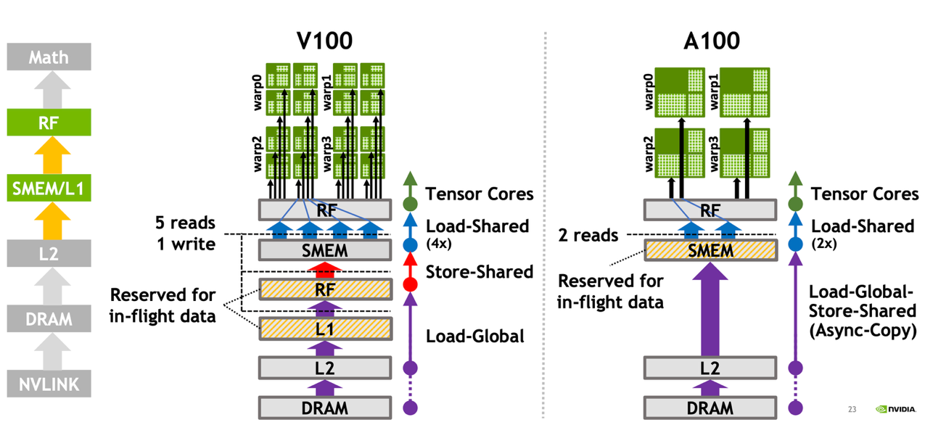
A100 data movement efficiency
3x SMEM/L1 bandwidth, 2x in-flight capacity
The A100 features an improved implementation where the L1 cache is part of a larger, more flexible memory subsystem within each SM, offering 1.5x more capacity than the V100's equivalent structure.
Register file
L1 OR shared memory
L2 is 7x larger in A100!
in-flight data = data that is actively being processed or transferred within the system but hasn't yet reached its final destination.

Slide 28
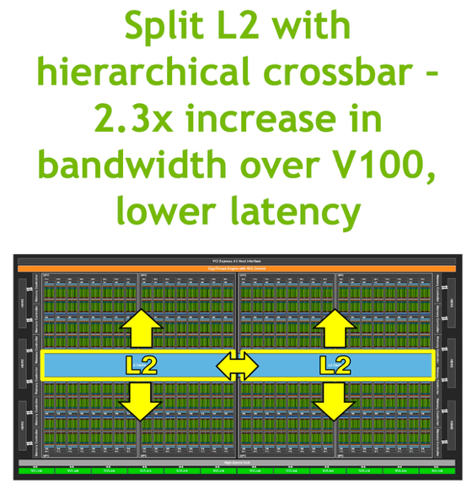
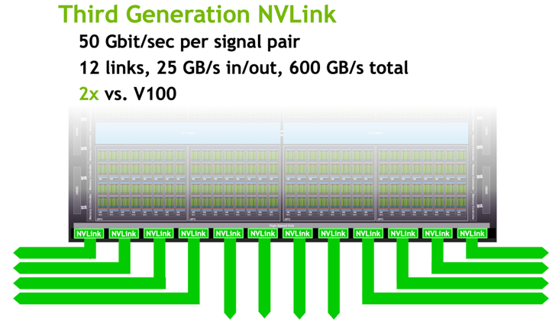
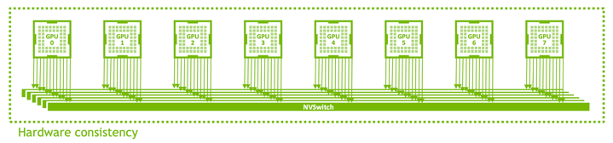
A100 data movement efficiency

Slide 29
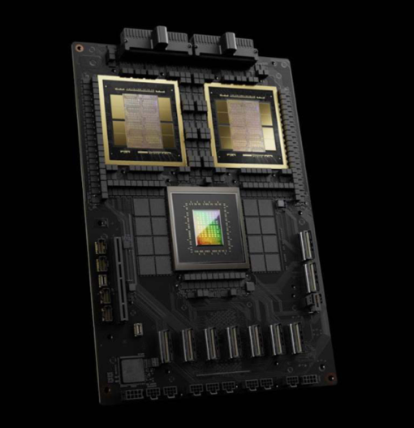
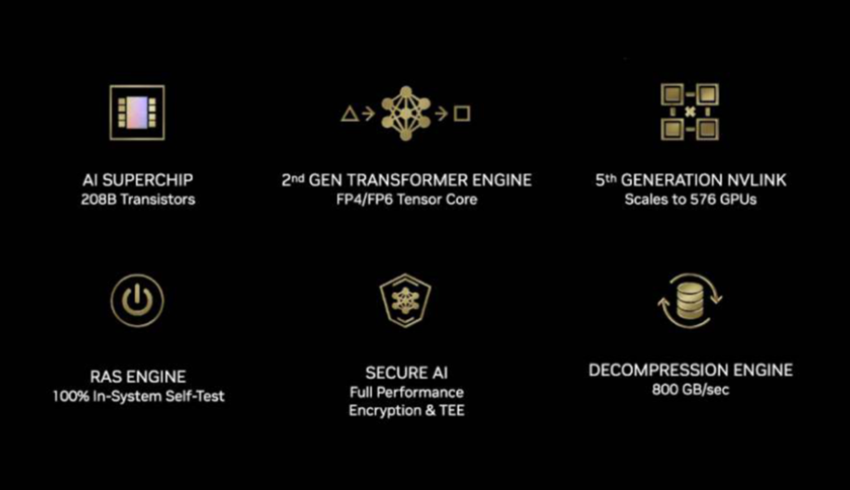
GB100 $40k, GB200: $70k
RAS (Reliability, Availability, and Serviceability)

Slide 30
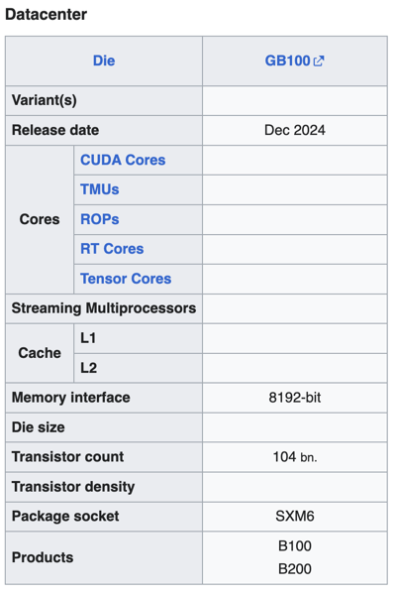
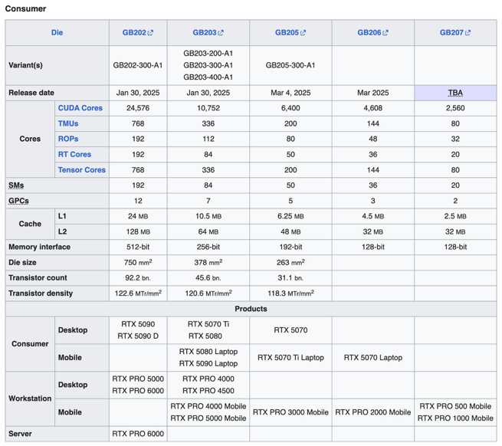

Slide 31

CUDA
CUDA (Compute Unified Device Architecture) is a parallel computing platform and programming model developed by NVIDIA.
It enables developers to use NVIDIA graphics processing units (GPUs) for general-purpose computing, a practice known as GPGPU (General-Purpose computing on Graphics Processing Units).
CUDA programs to be written without knowing the exact hardware configuration in advance.
Good resource: https://docs.nvidia.com/cuda/cuda-c-programming-guide

Slide 32
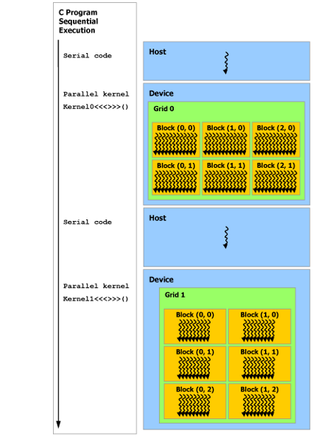

Programming and execution model
A GPU is built around an array of Streaming Multiprocessors (SMs). A multithreaded program is partitioned into blocks of threads that execute independently from each other, so that a GPU with more multiprocessors will automatically execute the program in less time than a GPU with fewer multiprocessors.
CUDA programming model assumes that the CUDA threads execute on a physically separate device that operates as a coprocessor to the host running the C++ program.
Serial code executes on the host while parallel code executes on the device.

Slide 33
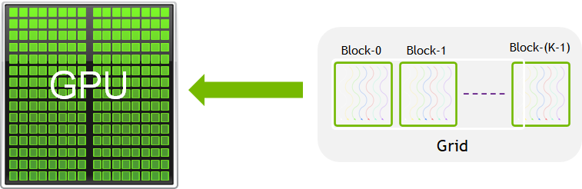
Some terminology
A warp in CUDA is a fundamental execution unit consisting of 32 threads that execute in lockstep. All 32 threads in a warp execute the same instruction at the same time on different data (SIMD: Single Instruction, Data).
A CUDA kernel is a function that runs on the GPU.
A block in CUDA (also called a thread block) is a fundamental organizational unit of threads that execute a kernel function.
The number of threads per block is limited (typically 1024 threads in modern GPUs), as they must reside on the same streaming multiprocessor (SM).
Thread blocks are composed of multiple warps. For example, a block of 128 threads would consist of 4 warps.
In CUDA programming, a kernel grid is the highest-level organization of threads when executing a CUDA kernel.

Slide 34
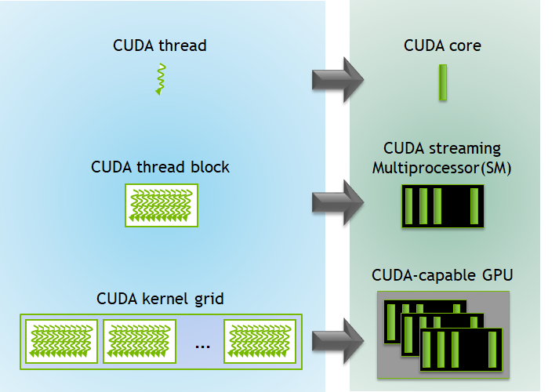
Programming and execution model
A GPU is built around an array of Streaming Multiprocessors (SMs). A multithreaded program is partitioned into blocks of threads that execute independently from each other, so that a GPU with more multiprocessors will automatically execute the program in less time than a GPU with fewer multiprocessors.

Slide 35
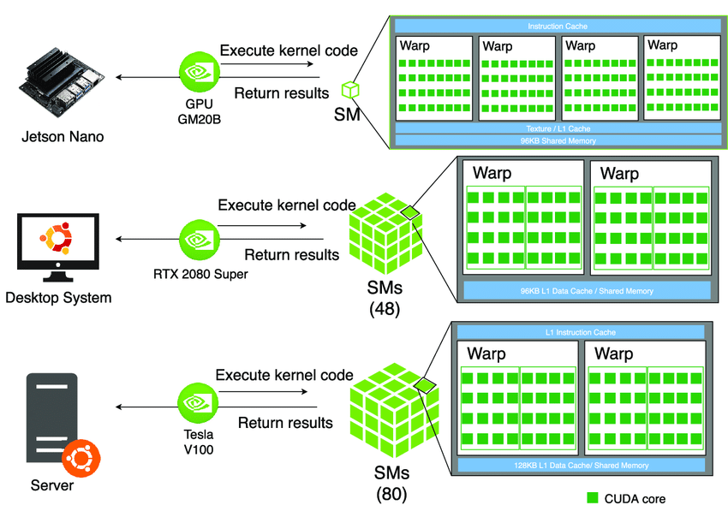
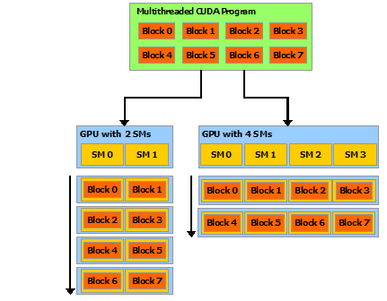
Automatic scalability
A GPU is built around an array of Streaming Multiprocessors (SMs). A multithreaded program is partitioned into blocks of threads that execute independently from each other, so that a GPU with more multiprocessors will automatically execute the program in less time than a GPU with fewer multiprocessors.

Slide 36
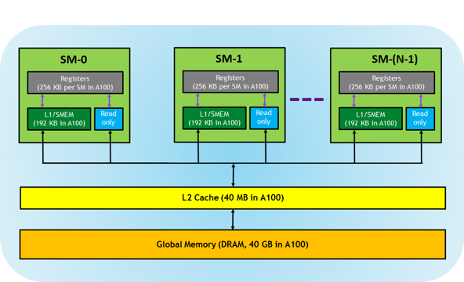
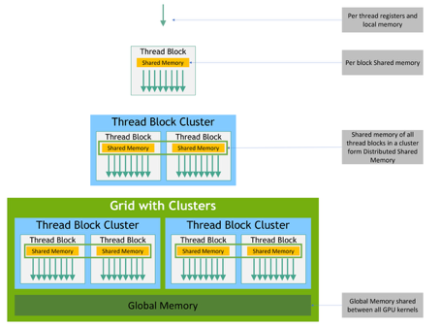
Memory hierarchy
CUDA threads may access data from multiple memory spaces during their execution.
Each thread has private local memory.
Each thread block has shared memory visible to all threads of the block and with the same lifetime as the block.
Thread blocks in a thread block cluster can perform read, write, and atomics operations on each other’s shared memory.
All threads have access to the same global memory.
Instruction cache

Slide 37
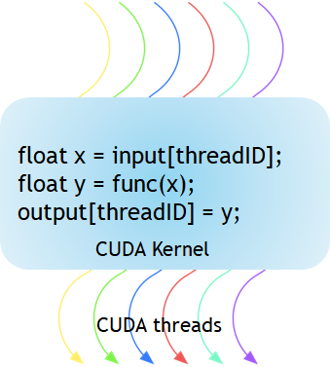

Kernels (1)
CUDA C++ extends C++ by allowing the programmer to define C++ functions, called kernels, that, when called, are executed N times in parallel by N different CUDA threads, as opposed to only once like regular C++ functions.
A kernel is defined using the __global__ declaration specifier and the number of CUDA threads that execute that kernel for a given kernel call is specified using a new <<<...>>> execution configuration syntax.
Each thread that executes the kernel is given a unique thread ID that is accessible within the kernel through built-in variables.
https://developer.nvidia.com/blog/cuda-refresher-cuda-programming-model

Slide 38



Kernels (2)
As an illustration, the following sample code, using the built-in variable threadIdx, adds two vectors A and B of size N and stores the result into vector C.
Single Instruction, Multiple Threads (SIMT)

Slide 39

Kernels (3)
kernel<<M,T>>
The kernel launches with a grid of M thread blocks. Each thread block has T parallel threads.
The information between the triple chevrons is the execution configuration, which dictates how many device threads execute the kernel in parallel.
In the CUDA programming model, we speak of launching a kernel with a grid of thread blocks.
The first argument in the execution configuration specifies the number of thread blocks M in the grid, and the second specifies the number of threads T in a thread block.
https://developer.nvidia.com/blog/cuda-refresher-cuda-programming-model

Slide 40

Kernels (4)
The CUDA program for adding two matrices below shows multi-dimensional blockIdx and threadIdx and other variables like blockDim. In the example below, a 2D block is chosen for ease of indexing and each block has 256 threads with 16 each in x and y-direction. The total number of blocks are computed using the data size divided by the size of each block.
https://developer.nvidia.com/blog/cuda-refresher-cuda-programming-model

Slide 41
Kernels (4)
What happens if you ask for more blocks than are physically available on the GPU?
https://developer.nvidia.com/blog/cuda-refresher-cuda-programming-model

Slide 42

Kernels (4)
What happens if you ask for more blocks than are physically available on the GPU?
The GPU doesn't reject your kernel launch. Instead, it schedules the execution of blocks over time. This is a key aspect of CUDA's execution model.
The GPU hardware scheduler automatically queues the blocks and executes them as resources become available.
Blocks waiting in the queue don't make progress until scheduled
The total execution time will increase as blocks must be processed sequentially
Memory for all blocks must still be allocated, potentially creating memory pressure.
GPUs have a metric called "occupancy" which represents how many threads can be active simultaneously relative to the theoretical maximum. The scheduler tries to maximize occupancy based on resource availability.
CUDA programs can be written without knowing the exact hardware configuration.
https://developer.nvidia.com/blog/cuda-refresher-cuda-programming-model

Slide 43

Another example
SAXPY stands for “Single-precision A*X Plus Y”
https://developer.nvidia.com/blog/easy-introduction-cuda-c-and-c

Slide 44
How to map a neural network on a GPU?

Slide 45

Multi-layer perceptron (MLP)
What parallelism can be exploited?

Slide 46


Multi-layer perceptron (MLP)
Data parallelism: You can process multiple training examples simultaneously. Since each example is processed independently through the forward pass, you can distribute batches across different computing units.
Model parallelism: The network itself can be partitioned, with different parts of the model assigned to different processors. This works particularly well for very large networks.
Layer-wise parallelism: Within each layer, the computations can be parallelized since neurons in the same layer operate independently.

Slide 47
Multi-layer perceptron (MLP)
Matrix multiplications: The core operation in MLPs (Wx + b) is highly parallelizable. Each output neuron's computation is independent.
Activation functions: These are applied element-wise and can be computed in parallel across all neurons.
Backpropagation: During training, gradient computations can be parallelized both within and across layers.

Slide 48



AlexNet: A classical deep convolutional neural network
AlexNet paper: https://papers.nips.cc/paper_files/paper/2012/file/c399862d3b9d6b76c8436e924a68c45b-Paper.pdf
Liu & Law, Artificial Intelligence Hardware Design, 2021

Slide 49




Exploiting parallelism

Slide 50



CUDA MLP (1)
…
16 batches

Slide 51

CUDA C++ Language Extensions
https://docs.nvidia.com/cuda/cuda-c-programming-guide

Slide 52


CUDA MLP (2)
Global thread ID (x coordinate)
Global y coordinate

Slide 53
CUDA MLP (3)
Why separate kernels for each layer?
Memory optimization: Each layer has different memory access patterns and working set sizes. Separate kernels allow you to optimize memory usage specifically for each layer's requirements rather than trying to find a one-size-fits-all approach.
Parallelism control: Different layers may benefit from different thread configurations. For example, the first layer in our implementation handles 4 inputs to 5 neurons, while the output layer handles 5 inputs to 1 neuron - these naturally map to different parallelization strategies.
Resource utilization: GPU resources like shared memory, registers, and thread counts can be tailored specifically to each layer's computational needs, which improves overall efficiency.
Kernel fusion limitations: While fusing operations into a single kernel can reduce launch overhead, there are practical limits to how much computation can be packed into one kernel before it becomes inefficient. Separate kernels help manage this complexity.
Synchronization points: Having distinct kernels creates natural synchronization points between layers, ensuring all computations from one layer are complete before the next layer begins processing.
Debugging and profiling: With separate kernels, it's easier to identify performance bottlenecks or errors in specific parts of the network.
Specialized optimizations: Different mathematical operations may benefit from specialized implementations - convolutions, fully-connected layers, and activation functions all have different optimal implementations on GPUs.

Slide 54
CUDA MLP (4)
How much should be in a kernel?
The optimal kernel size involves balancing several trade-offs:
Kernel launch overhead: Each kernel launch incurs some overhead. Too many small kernels can result in performance degradation due to this overhead.
Register pressure: Larger kernels with more operations typically require more registers per thread, which can reduce occupancy (the number of threads that can run simultaneously on the GPU).
Instruction cache: GPUs have limited instruction cache. Very large kernels might not fit well in the cache, causing additional latency.
Memory bandwidth utilization: Kernels that load data, perform a small operation, and then store results can be memory-bound. Combining multiple operations in one kernel can improve arithmetic intensity and make better use of compute resources.
Thread divergence: If your kernel contains many conditional branches that cause different threads to follow different execution paths, performance will suffer.
As a general guideline:
Good candidates for fusion: Operations that work on the same data and have similar parallelization patterns (like a matrix multiplication followed by an element-wise activation function).
Better kept separate: Operations with fundamentally different access patterns or parallelization strategies.

Slide 55

CUDA MLP (5)

Slide 56


CUDA MLP (6)

Slide 57


CUDA MLP (7)
How will we use threads for this MLP?
A GPU is built around an array of Streaming Multiprocessors (SMs). A multithreaded program is partitioned into blocks of threads that execute independently from each other.

Slide 58

CUDA MLP (8)
Why?
kernel<<M,T>>
The kernel launches with a grid of M thread blocks. Each thread block has T parallel threads.
A GPU is built around an array of Streaming Multiprocessors (SMs). A multithreaded program is partitioned into blocks of threads that execute independently from each other.

Slide 59

CUDA MLP (9)

Slide 60


Deep learning frameworks
Deep learning frameworks provide interfaces to implement AI functionalities regardless of hardware or computing platforms.
Most deep learning frameworks also optimize the network in a hardware-friendly manner and utilize the hardware resources and acceleration functions as much as possible.
Because GPUs are commonly used in deep learning, deep learning frameworks widely support constructing and deploying neural networks on GPU and actively reflect the acceleration support from GPU vendors.
In addition, they provide optimizations on standalone accelerators such as TPU and specific environments such as cloud servers.
Mishra, Ashutosh; Cha, Jaekwang; Park, Hyunbin; Kim, Shiho. Artificial Intelligence and Hardware Accelerators, 2025

Slide 61
PyTorch & CNNs
For CNNs, the mapping process involves:
Tensor operations: PyTorch represents all data (images, weights, activations) as tensors that can be moved between CPU and GPU memory.
Layer-by-layer optimization: Each CNN layer (convolution, pooling, etc.) is mapped to specific GPU kernels that efficiently perform the required operations in parallel.
Memory management: PyTorch handles the complex memory allocations and transfers between host (CPU) and device (GPU) memory.
Computation graphs: PyTorch builds a dynamic computation graph that tracks operations and enables automatic differentiation for training.
Batching: Multiple inputs are processed simultaneously to maximize GPU utilization.
For the convolution operations specifically, PyTorch typically uses highly optimized libraries like cuDNN that implement various algorithms (direct convolution, FFT-based, Winograd, etc.) and automatically select the most efficient one based on input size and available GPU resources.

Slide 62


PyTorch

Slide 63
GPU vs TPU

Slide 64
GPU vs TPU
 | GPU | TPU
Origin and design purpose | Graphics | Created by Google for ML
Architecture | Thousands of smaller cores designed for parallel processing. | More specialized architecture with matrix processing units (MXUs) specifically optimized for tensor operations.
Performance focus | More flexibility, broader applicability | Optimized for matrix operations and ML workloads.
Development and availability | NVIDIA, AMD, etc. | Proprietary, only through Google cloud
Software compatibility | Various frameworks, e.g., CUDA | TensorFlow
Power efficiency | Less power-efficient, but more flexibility | More power-efficient

Slide 65

Hardware for AI/ML
Mishra et al., 2023

Slide 66

Architecture of a TPU accelerator
The main component of TPU is the MXU that consists of 256 by 256 (i.e., 65,536) MACs to perform 8-bit mathematical operations.
The MXU gets its input from the weighted FIFO and unified buffer (UB).
Mishra et al., 2023

Slide 67

Hardware for AI/ML
Mishra et al., 2023

Slide 68

General AI accelerator architectures of FPGA and ASIC
Mishra, Ashutosh; Cha, Jaekwang; Park, Hyunbin; Kim, Shiho. Artificial Intelligence and Hardware Accelerators, 2025

Slide 69

DSP comparison
https://www.synopsys.com/blogs/chip-design/arc-vpx6-digital-signal-processor.html

Slide 70
Google’s TPU
https://cloud.google.com/tpu/docs/system-architecture-tpu-vm

Slide 71

https://doi.org/10.1007/s11227-016-1633-y

